Slide 1
VOCALIS PTToC +
Simply Superior
What makes VOCALIS PTToC + superior ? It is not attached to any one Cellular Network. VOCALIS PTToC + uses SORACOM.io network agnostic SIMs and Airtime. Roam across Canada, USA and Mexico or even world wide, and you should always have cellular service with typically lower costs!
You can also stream live video.
And works in Helicopters and Small Aircraft

Slide 2
GLOBAL SERVICE delivered by SORACOM.IO
SUPERIOR COVERAGE Network Agnostic SIMs Cover More Places Than Any One Carrier
Using VOCALIS + with network agnostic Soracom.io SIMs allows for more coverage than any one carrier can provide. No matter your location, your device connects to the strongest signal.
VOCALIS + is based on LINUX a superior operating system. Eschat and others are based on Android which is a Sub-Set of LINUX. VOCALIS + will also run on Android and iOS. However, for best performance use LINUX based terminals such as Tesunho.

Slide 3
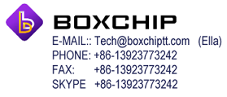
WORKS WITH A WIDE CHOICE OF HARDWARE
VOCALIS + works with a wide choice of terminals using LINUX, Android or iOS.
VOCALIS + is linked to Datalink’s WebGate and also a bridge to LMR radios for GPS and two-way messaging.
Datalink recommends the BoxChip S900B for 4G
And the S900A for dual mode DMR and 4G
Mention Datalink to get reseller pricing

Slide 4
The ANYSECU 4G-W2
PTT VEHICLE TERMINALS
The ANYSECU 4G-W2 WCDMA/GSM LTE Dash mount for easy access for the Truck and Bus Driver. The 4G-W2 PTT Radio is the perfect choice for the Driver who wants a larger display.
Audio quality is loud and clear.
ORDER INQUIRIES
Shenzhen Anysecu Technology Co. Ltd.
Skype:lynn2012260
E-mail: sales04@szanysecu.com
Mention Datalink to get reseller pricing

Slide 5
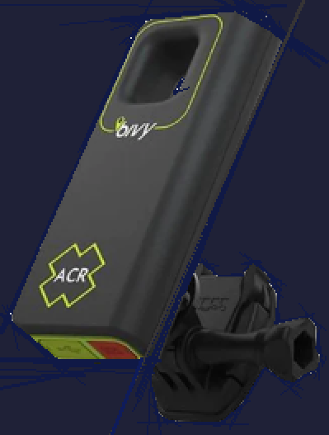
ACR BIVYSTICK Pocket sized Iridium and Bluetooth GPS and SOS Tracking unit with texting
Use the Bivy Stick to turn your cell phone into a satellite communication device. Using global satellite coverage via the Iridium satellite network, anywhere you have a view of the sky you can communicate through the Bivy Stick.
While conveniently compact, the Bivy Stick offers a comprehensive feature set including two-way text messaging, GPS tracking, SOS, location sharing, one-touch Check-in, and detailed weather reports sent straight to your cell phone via satellite. Only $290

Slide 6

ABOVE and BEYOND all others
VOCALIS + delivers complete communications for long-haul Trucking Companies. Two-Way Nation-Wide PTT + Live Reefer Temperature Monitoring + Engine Bus and Safe Driver Monitoring.
Skelton Truck Lines based in Canada, transports pharmaceutical and blood products across Canada and America in various temperature controlled compartments. Monitoring is live, linked over cellular Networks, with Iridium Satellite back-up. Datalink was contracted to develop the monitoring and communications system.

Slide 7
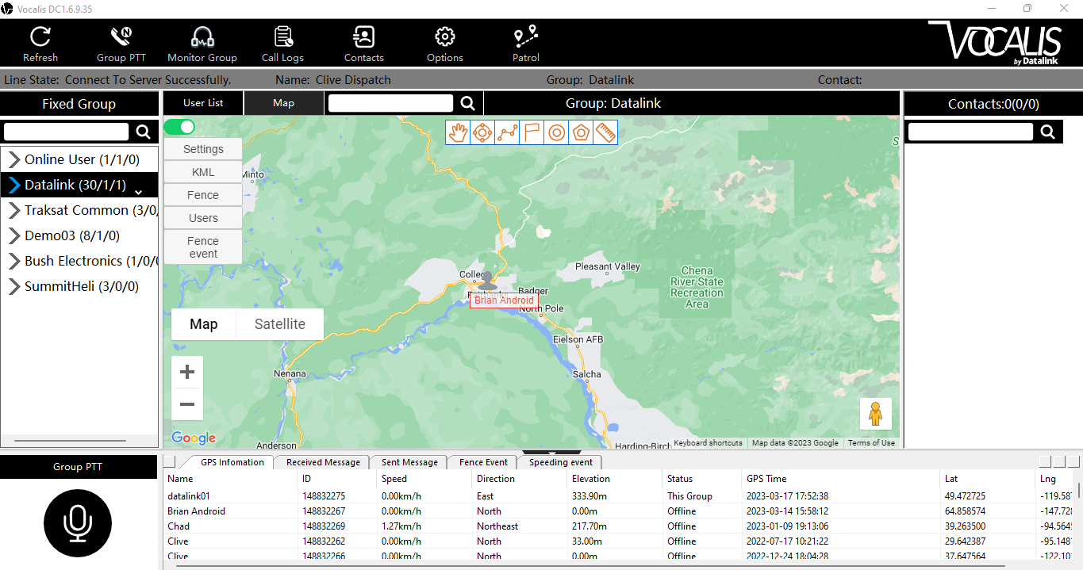
Dispatch Console
Fairbanks Alaska

Slide 8
VOCALIS PRICING
END USER COST
Dispatch Desk or Mobile Supervisors…Included with WebGate License
Mobile Terminals including SmartPhones….……....Billed Quarterly..$ 29
DISTRIBUTOR AND DEALER DISCOUNTS APPLY
NOTE! All hardware and network airtime services are contracted directly.
Datalink partners with www.Soracom.io for Global Network Agnostic SIMS
Please contact our regional Sales Agencies for more information
Copyright: Datalink Systems International Inc. 2023

Slide 9
SORACOM.IO
Who We Are
Founded by Amazon AWS veterans and Telco engineers, Soracom is a global team of technologists, strategists, builders and storytellers dedicated to creating a more connected world. We live and work in Tokyo, Seattle, Chicago and London.
Datalink International chose Soracom as its 4G/5G “GoTo” partner for Global VoiP and data connectivity. Datalink also partners with Kenwood NXDN LMR/PMR Resellers around the world. Many of whom are now adding cellular data and VoiP to their sales portfolios.
Datalink provides a SaaS service via AWS CLOUDS and recommends its many resellers to select SORACOM.IO as their 4G/5G Cellular service provider.
For Support Contact: Brandon Stephens. brandon@soracom.io

Slide 10
VOCALIS + by Datalink Systems
Please contact our regional Sales Agencies for more information

